Slide 1


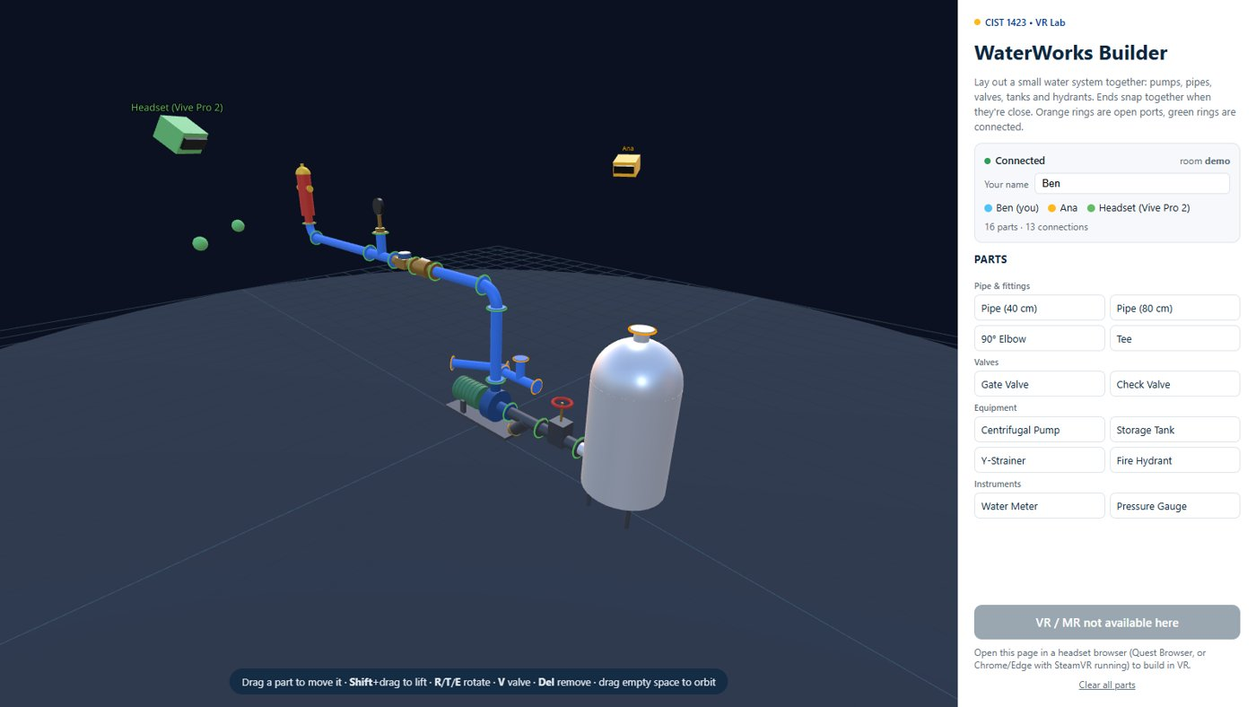

Virtual Reality
Advanced XR: hand tracking, eye and head gaze, and multiplayer
Wednesdays at 6:00pm
CIST 1423 - 2010 VIRTUAL REALITY PROGRAMMING AND TECHNOLOGY
Homework: prototype one advanced feature and document your approach

Slide 2



Agenda
Hand tracking
Eye & head gaze
Multiplayer
XRI Hands, SteamVR skeletons, WebXR hands
Looking as input: dwell to select
PUN in the book, our WaterWorks relay

Slide 3

Today
By the end of class you can…
Name the four multiplayer problems: meeting, authority, sync, presence
Tonight's plan
1
0–10
Review
Explain grab ownership with a two-person race
2
10–25
Hands + gaze
25–45
Unplugged: be the network
Explain interpolation between 15 Hz updates
3
45–85
PUN vs relay, live WS frames, code reading
Implement head-gaze dwell selection and avoid the Midas touch
85–135
Lab: one advanced feature
4
135–150
Share-out + exit
CIST 1423 — Week 12 — Building Advanced XR Techniques (Ch. 8)
Notes:
Full lesson plan: Lesson-Plans/Week-12-Multiplayer.md

Slide 4
Hand tracking on each platform
Same data everywhere: a pose per finger joint, every frame.
Platform | API | Hardware | Notes
Unity + XRI (book) | XR Hands package, XRHandSubsystem | Quest (camera hands) | Poke / pinch interactors
Unity + SteamVR (lab) | SkeletonLeftHand / RightHand actions | Index Knuckles, Vive wands (estimated) | Hand.skeleton, finger curls
WebXR | optionalFeatures: ['hand-tracking'] | Quest Browser | XRHand: 25 joints per hand
Hands need bigger targets and forgiving colliders. No trigger means "pinch" or "poke" is the click.
CIST 1423 — Week 12 — Building Advanced XR Techniques (Ch. 8)

Slide 5


Head gaze + dwell to select
Works on every headset (no eye tracker needed). Eye gaze uses the same logic with an eye ray.
public class GazeDwell : MonoBehaviour
{
public Transform head; // the VR camera
public float dwellSeconds = 1.2f;
GameObject current; float timer;
void Update()
{
GameObject hit = null;
if (Physics.Raycast(head.position, head.forward, out var h, 10f))
hit = h.collider.gameObject;
if (hit != current) { current = hit; timer = 0; return; }
if (current == null) return;
timer += Time.deltaTime; // show a filling ring here
if (timer >= dwellSeconds)
{
current.SendMessage("OnGazeSelect",
SendMessageOptions.DontRequireReceiver);
timer = float.NegativeInfinity; // once, until you look away
}
}
}
The "Midas touch" problem
Everything you look at gets selected
Dwell time + visible progress fixes it
Accessibility win
Gaze works for users who can't use controllers
CIST 1423 — Week 12 — Building Advanced XR Techniques (Ch. 8)

Slide 6



Multiplayer, live: WaterWorks Builder
Relay with memory
Node + WebSocket, one room per ?room=
Keeps the part list for late joiners
Ownership
Only one holder per part
Second grab → grab-denied
15 Hz + smoothing
Poses sent 15×/s
Everyone else lerps/slerps between them
Ben's view: Ana (yellow, desktop) and a Vive Pro 2 user (green, head + hands) in the same room, 16 shared parts.
CIST 1423 — Week 12 — Building Advanced XR Techniques (Ch. 8)

Slide 7
PUN (textbook) vs our relay
Same four problems, different names.
Problem | Photon PUN (Ch. 8) | WaterWorks (Week-07-WebXR-WaterWorks)
Where do players meet? | Photon Cloud room, NetworkManager joins it | server.mjs relay, ?room=lab
Who controls an object? | PhotonView ownership / RequestOwnership | heldBy; server grants grab or sends grab-denied
Keeping positions in sync | PhotonTransformView, OnPhotonSerializeView | move {id,p,q} at 15 Hz, workspace.smooth()
Showing other people | Avatar prefab: head, hands, animated fingers | avatars.js: visor head, hands, name tag
Late joiners | Buffered RPCs / room properties | welcome snapshot of peers + parts
CIST 1423 — Week 12 — Building Advanced XR Techniques (Ch. 8)

Slide 8


The server rule that makes it fair
server/rooms.mjs: pure logic, unit-tested, no networking inside.
case 'grab': {
const part = this.parts.get(msg.id);
if (!part) return [];
if (part.heldBy && part.heldBy !== from) {
// someone got there first: tell only the loser
return [{ to: from, msg: { t: 'grab-denied', id: part.id,
heldBy: part.heldBy, p: part.p, q: part.q } }];
}
part.heldBy = from;
return [{ to: 'others', msg: { t: 'grab', id: part.id, by: from } }];
}
Tested
rooms.test.mjs: ownership, leaving drops held parts
relay.test.mjs: two real clients race for a pump
Try it
npm start in Week-07-WebXR-WaterWorks
Two browsers + a headset, same URL
CIST 1423 — Week 12 — Building Advanced XR Techniques (Ch. 8)

Slide 9
Check your understanding
Answer with a partner first, then we'll compare.
Q1
Q2
Two people grab the same pipe at once. What happens?
Updates arrive 15×/s. Why does motion look smooth?
Q3
Q4
What is the "Midas touch" problem?
PUN's PhotonView ownership maps to what in WaterWorks?
CIST 1423 — Week 12 — Building Advanced XR Techniques (Ch. 8)
Notes:
Answers:
Q1. Two people grab the same pipe at once. What happens?
The server grants the first grab to arrive; the other gets grab-denied and their copy snaps back.
Q2. Updates arrive 15×/s. Why does motion look smooth?
Clients interpolate (lerp/slerp) toward the latest pose every frame.
Q3. What is the "Midas touch" problem?
Everything you look at gets selected. Fix: dwell time plus visible progress.
Q4. PUN's PhotonView ownership maps to what in WaterWorks?
heldBy, enforced by the server's grab rule.

Slide 10

Next steps: homework + planning
Prototype one advanced feature: hand tracking, gaze interaction, or a basic multiplayer connection
Document your approach in Markdown (what you tried, what worked)
Multiplayer option: add a feature to WaterWorks (undo, pipe sizes, flow check)
Next week: Ch. 9, best practices, trends, and collaboration
CIST 1423 — Week 12 — Building Advanced XR Techniques (Ch. 8)

